Slide 1
Bacteria Group B
By:
Abdullah Alandanusi
Menchie Diaz
Erika Huber
Morgana McLaughlin
Chi Yu
Lucia Abarca

Slide 2
Bacteria Group-B
Burkholderia Pseudomallei
Listeria Monocytogenes
Salmonella Enterica
Shigella spp.
Francisella Tuleremia
Pseudomonas Aeruginosa

Slide 3
Burkholderia Pseudomallei
Abdullah Alandanusi

Slide 4
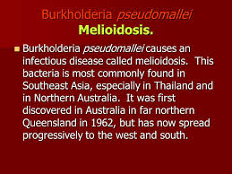

Slide 5
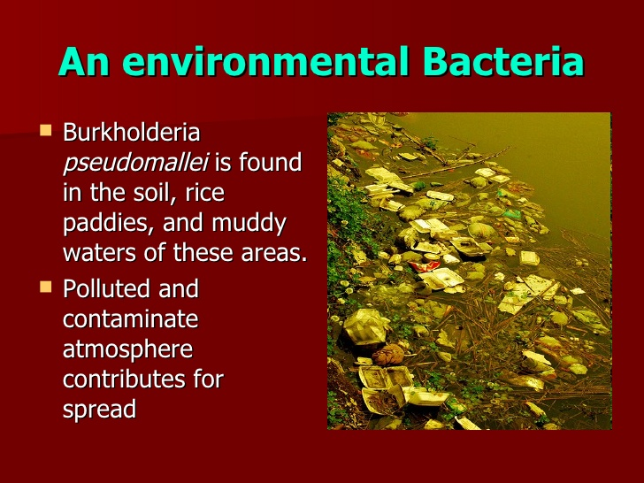
Natural habitat/Environment
Soil
Rice paddies as well as
Stagnant waters (Torres and Steinmetz, 2011)

Slide 6
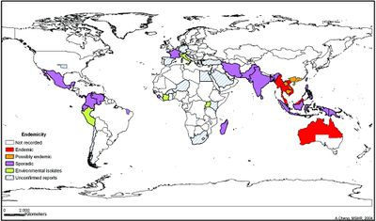
Region where it can be found.
Tropical and subtropical regions;
Thailand, Malaysia, Singapore and Northern Australia
Southeaast Asia, South Asia and China
Papua Guinea and New Caledonia

Slide 7
Reservoir
The soil
Contaminated water
Predominant during rainy season (Torres et al., 2011)

Slide 8
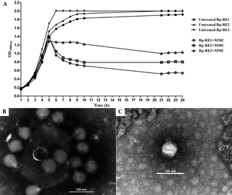
Host Range
Dependant on the phages (Gatedee et al, 2011)
Isolation of a podovirus

Slide 9
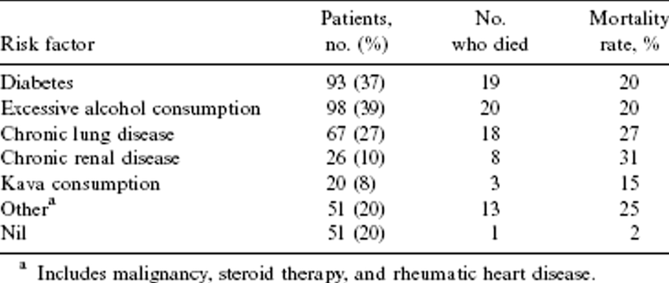
Predisposing & Occupational Risks, Disease? Infectious Dose?
Predisposing risks; smokers, diabetic patients, alcohol abusers, chronic renal and lung diseases, liver infections, thalassemia, kava consumption and cancer (Torres et al., 2011)
Occupational risks; people working or staying in Southeast Asia and Northern Australia as well as other
Infectious dose- 10 colony forming units

Slide 10
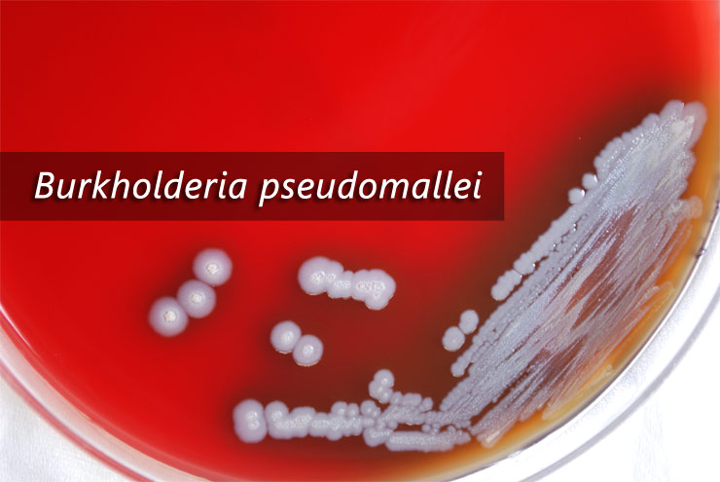
Mode of transmission?
Soil and surface waters
Inhaling dust or water droplets

Slide 11
References
Gatedee et al. (2011). Isolation and Characterization of a Novel Podovirus which Infects Bukholderia Pseudomallei. Virolohy Journal. Retrieved from https://www.biomedcentral.com/track/pdf/10.1186/1743-422X-8-366?site=virologyj.biomedcentral.com on November 9, 2017.
Torres, A & Steinmetz, I. (2011).Recent Progress in Melioidosis and Glanders. Frontiers E-books Publishers.

Slide 12
Listeria Monocytogenes
Menchie Diaz

Slide 13
Where does it naturally live?
Also known as Listeriosis or Listerella
Listeria Monocytogenes is a bacteria that naturally live in soil and water in the environment.
Characteristics: Gram-positive, non-spore forming, aerobic bacilli; hemolytic and catalase positive; it has a tendency to form chains and palisades, growth at 4° C, intracellular; food-borne human pathogen usually caused by serovars 1/2a, 1/2b and 4b.

Slide 14
Regions where it can be found?
Listeria are found in regions of:
  North/South/Central American regions
  Europe (stretching from Poland to Turkey)
  Africa
  Oceania
  East/Southeast Asia
  Africa
  Polynesia
  India.
**** Number of isolates from 7 world regions where the most prevalent clones of Listeria monocytogenes are found.

Slide 15
Listeria Monocytogenes
Reservoir
Infected domestic and wild mammals, fowl and humans; infection of foxes produces an encephalitis simulating rabies; asymptomatic fecal carriage in man (5%) and animals; frequently found in free-living water and mud; seasonal use of silage as fodder is frequently followed by an increased incidence of listeriosis in animals.
All Listeria species are ubiquitously distributed in nature and can often be found in soil, decaying plants, sewage, silage, dust, and water (3, 19). It can be present in raw milk and foods made from raw milk. It can also live in food processing plants and contaminate a variety of processed meats and foods.
Host Range
Mammals, birds, fish, crustaceans and insects

Slide 16
Listeria Monocytogenes
Predisposing & Occupational Risks?
Pregnant women, older adults and people with weakened Immune System
Disease?
Most people with invasive listeriosis (meaning the bacteria has spread beyond the gut, depend on whether the person is pregnant) require hospital care, and about one in five people with the infection die. When listeriosis occurs during pregnancy, it can cause miscarriage, stillbirth, or newborn death. Listeriosis during pregnancy results in fetal loss in about 20% and newborn death in about 3% of cases.
Sign and Symptoms:
  Pregnant women: Pregnant women typically experience only fever and other flu-like symptoms, such as fatigue and muscle aches. However, infections during pregnancy can lead to miscarriage, stillbirth, premature delivery, or life-threatening infection of the newborn.
  People other than pregnant women: Symptoms can include headache, stiff neck, confusion, loss of balance, and convulsions in addition to fever and muscle aches.
  People with invasive listeriosis usually report symptoms starting 1 to 4 weeks after eating food contaminated with Listeria; some people have reported symptoms starting as late as 70 days after exposure or as early as the same day of exposure.

Slide 17
Who is at Risk?

Slide 18
Infectious Dose & Mode of transmission
Infectious dose was determined as 10⁷ CFU. Other papers suggest even 100 CFU.
In neonates, transmission from mother to fetus in utero or during passage through infected birth canal; direct contact with infectious material or soil contaminated with infected animal feces can result in popular lesions on hands and arms; ingestion of contaminated food (vegetables and dairy products have been reported); venereal contact and inhalation of the organism is possible; nursery outbreaks via hands of medical staff.

Slide 19
Listeria Monocytogenes
Fun Facts:
It is possible for vegetables to become contaminated by Listeria when growing in contaminated soil, or when manure is used a fertilizer
Pregnant Hispanic women are 24 times more likely than the general population to get Listeria infection.
The genus Listeria consists of six species:
L. monocytogenes
L. ivanovii
L. innocua
L. welshimeri
L. seeligeri
L. grayi

Slide 20
References
https://www.livescience.com/50582-what-is-listeria.html
https://en.wikipedia.org/wiki/Listeria_monocytogenes
http://www.halton.ca/cms/One.aspx?portalId=8310&pageId=13640
http://www.foodsafetynews.com/2014/10/study-measures-global-burden-of-listeria/#.WfTEGxNSzVo
https://www.foodsafety.gov/poisoning/causes/bacteriaviruses/listeria/index.html
https://www.cdc.gov/listeria/risk.html
https://www.msdsonline.com/resources/msds-resources/free-safety-data-sheet-index/listeria-monocytogenes/
https://image3.slideserve.com/6620525/listeria-monocytogenes1-n.jpg

Slide 21
Salmonella Enterica
Erika huber

Slide 22
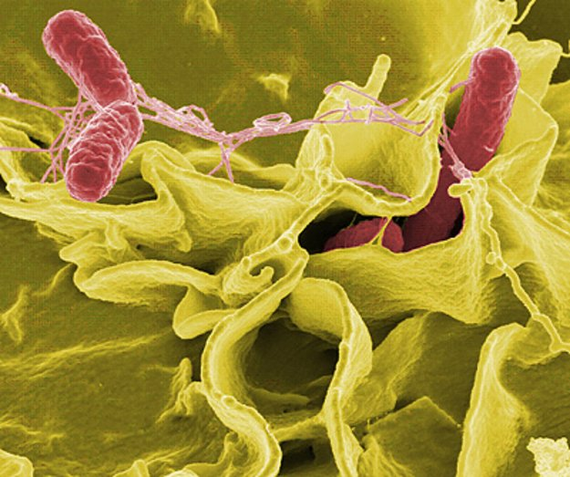
Where does it naturally live?
Natural environment?
Rod-shaped
Gram-negative
Facultatively anaerobic bacteria in the Enterobacteriaceae family
Principal habitat is the intestinal tract of humans and other animals

Slide 23
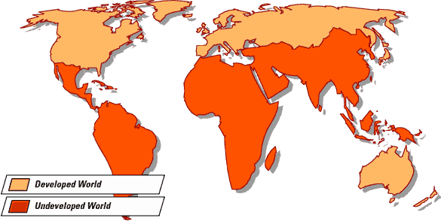
Region where it can be found
The epidemiology of non-typhoid salmonellosis is geographically distinct between the developed and developing regions of the world.
Developed world – driven by the agricultural industry as well as by the improper handling and cooking of food products.
Developing world – associated with nosocomial outbreaks, rather than foodborne outbreaks

Slide 24
Reservoir
The Salmonella pathogens are maintained in animal reservoirs, and infection in humans follows ingestion of contaminated animal products or ingestion of produce contaminated with infected animal feces.
Poultry is the reservoir for S. Enteritidis, which has caused the greatest number of cases of gastroenteritis salmonellosis in the United States and Europe.

Slide 25
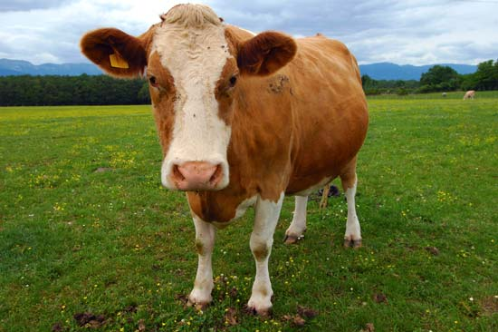
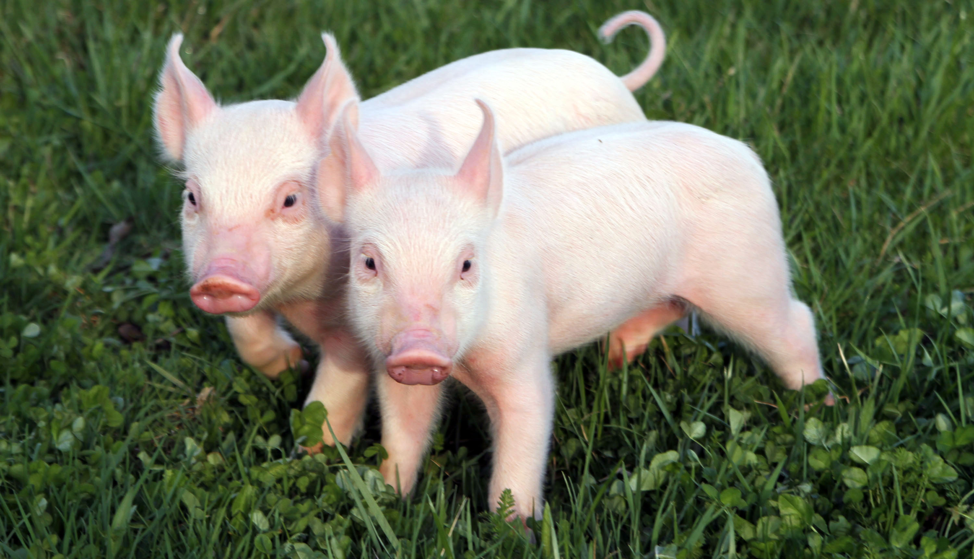
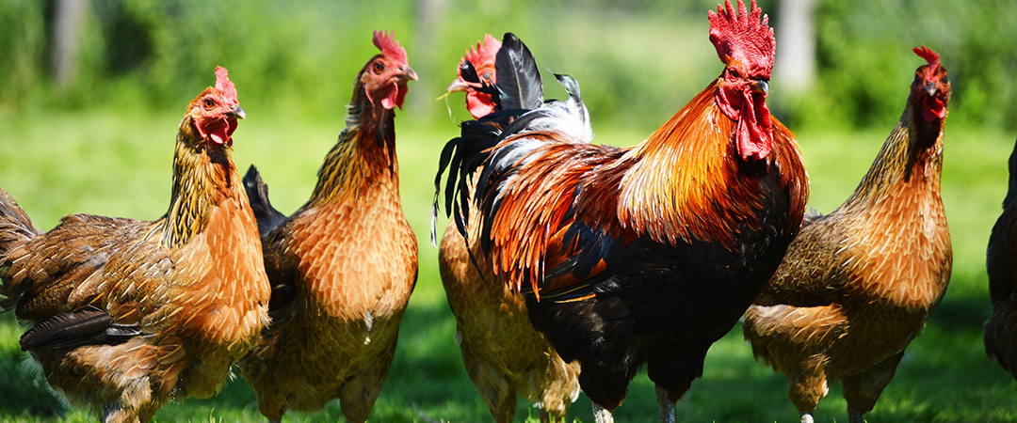
Host range
For serotypes causing non-typhoidal salmonellosis, the primary hosts are domestic and wild animals such as cattle, swine, poultry, wild birds, and pets (particularly reptiles) as well as flies.
Humans are usually the final host.
For Salmonella Typhi, humans are the only known host.

Slide 26
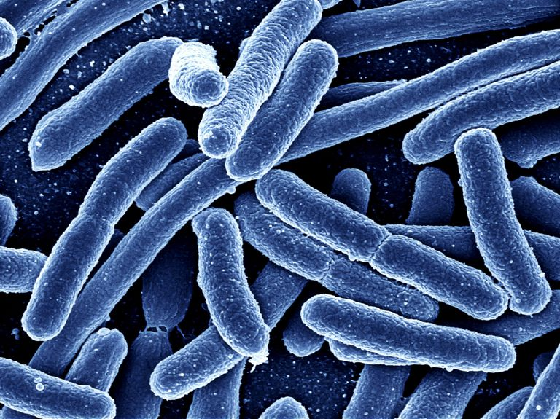
Predisposing & Occupational Risks
Disease? Infectious Dose?
Predisposing risks for salmonella are next to none.
Occupational risks for salmonella have rarely been studied.
Non-Typhoidal Salmonellosis – approximately 103 bacilli
Enteric Fever – 105 bacilli by ingestion
Patients with achlorhydria, depressed cell-mediated immunity, or who are elderly may become infected with at a lower infectious dose.

Slide 27


Mode of transmission?
Human infection occurs when
  Consuming contaminated foods and water
  Contact with infected feces
  Contact with infective animals, animal feed, or humans.
To decrease transmission
  1. Cook all food thoroughly
  2. Segregate food preparation areas and utensils
  3. Wash all food thoroughly

Slide 28
References
http://www.infectionlandscapes.org/2011/10/salmonellosis.html
https://www.msdsonline.com/resources/msds-resources/free-safety-data-sheet-index/salmonella-enterica-spp.aspx

Slide 29
Shigella spp.
Morgana Mclaughlin

Slide 30
Shigella spp.
Shigella sonnei (group D)
Shigella boydii (group C)
Shigella flexneri (group B)
Shigella dysenteriae (group A)

Slide 31
Natural Environment
Shigella spp. is found in the stool of infected individuals
Shigella can be found in contaminated water or food
Shigella can survive, independent of human contact
  Up to months on dry surfaces and over 3 hours on fingers
  Up to 10 days in citric juices and carbonated soft drinks
  Several days on contaminated vegetables and up to 28 days on metal utensils
  In feces for up 12 days and water for under 3 days.

Slide 32
Region
Shigellosis is mostly caused by S.sonnei in industrialized countries
Shigellosis is mostly caused by S. flexneri in the developing world
S. boydii and S. dysenteriae most common cause of Shigella spp. found in sub-Saharan Africa and South Asia
Risk of infection caused by Shigella spp. was highest for people traveling to Africa, followed by Central America, South America, and Asia

Slide 33
Reservoir & Host Range
Only humans and higher primates carry Shigella
The host range includes humans and higher primates
Human beings are the main reservoir of Shigella species, but infections have been observed in primates
Flies can carry Shigella for up to 20 – 24 days.

Slide 34
Risks: Predisposed
People that are predisposed to contracting shigellosis
  Young children
  Travelers
  Men who have sex with men
  People whose immune systems are weakened due to illness
  Mothers
  Day-care workers

Slide 35
Risks: Occupational
Laboratory Personnel
  Most frequently identified agent of laboratory-acquired infections because of their high virulence and low infectious dose.
  Experimentally infected guinea pigs and other rodents have been previously reported to transmit infection to laboratory personnel, although rare
Day-care centers
  Most frequent for staff who change diapers and provide transportation for children from their homes to the center
Families
  With a child younger than 6 years old who attends day care

Slide 36
Infection
Shigella spp. causes dysentery
Infection can result from ingestion of 10 – 200 organisms
Incubation period ranges from 1 – 7 days
Acute diarrhea can develop within 1 – 2 days
Symptoms and shigellosis may occur within 12 – 50 hours
**This micrograph reveals 2nd stage shigellosis progression; the Shigella bacteria have penetrated the intestinal mucosa.

Slide 37
Transmission
Shigellosis is easily transmitted
Transmission occurs via the fecal-oral route
  Direct person-to-person or anal sexual contact
  Indirect contact through contaminated food, water, or fomites
Agents begin to be shed in feces 4 weeks after infection, and it is communicable as long as the organisms are present in excrement
Although rare, asymptomatic carriers can also spread the infection for up to several months

Slide 38
References
https://www.cdc.gov/shigella/general-information.html
http://www.sanger.ac.uk/news/view/shigella-flexneri-persists-environment-and-switches-serotypes
https://www.foodsafety.gov/poisoning/causes/bacteriaviruses/shigella/index.html
https://wwwnc.cdc.gov/travel/yellowbook/2018/infectious-diseases-related-to-travel/shigellosis
https://www.uta.edu/campus-ops/ehs/biological/docs/PSDS/SHIGELLA%20spp.pdf
https://www.ncbi.nlm.nih.gov/pubmed/7762715
https://www.cdc.gov/shigella/infection-sources.html
http://userscontent2.emaze.com/images/be707218-efe8-4354-9aec-de15f02d8a10/5a5f141a-038c-46a5-92c5-ed96b80b9acd.jpg

Slide 39
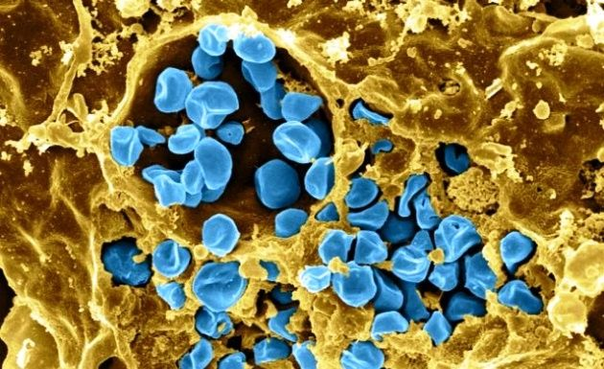
Francisella tularemia
By: Chi Yu

Slide 40
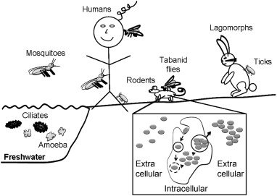
Where does it naturally live? Soil ? Natural environment.
Francisella tularemia is found in a wide variety of hosts and extra host environments, making culture recovery a diagnostic challenge. When it found in nature, it can survive for several weeks at low temperatures in animal carcasses, soil, and water. In laboratory, Francisella tularemia appears as small rods (0.2 by 0.2 µm), and is grown best at 35-37 degrees Celsius.

Slide 41
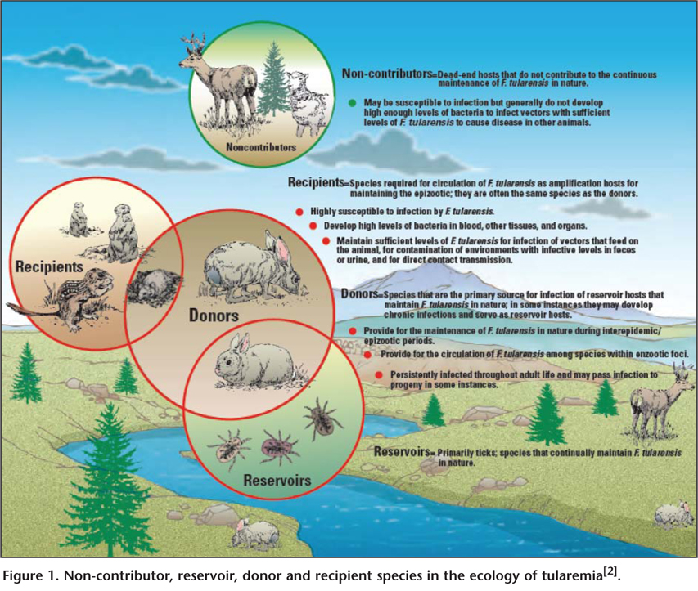
Region where it can be found &Reservoir
Francisella tularemia is associated with various aquatic environments including streams and rivers, lakes and pond.
Various wild animals, especially rabbits, hares, and rodents, plus several species of hard ticks.
NOTE: This bacterium also exists in water and in soil.

Slide 42
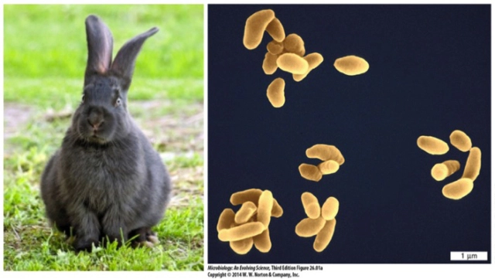
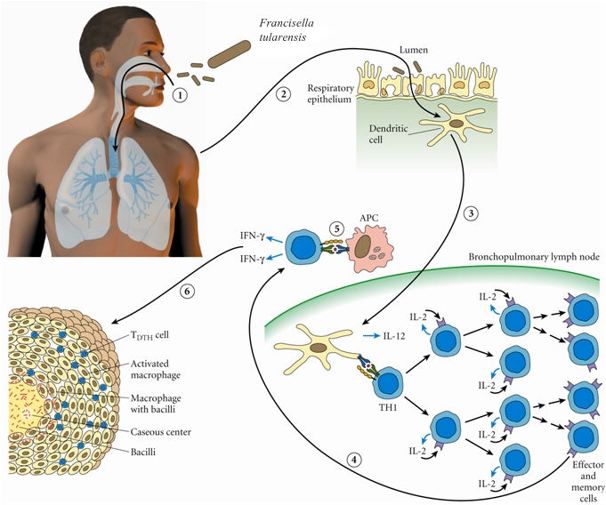
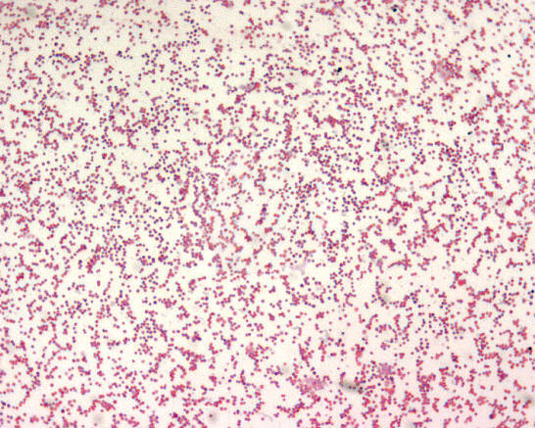
Host Range
Francisella tularemia is a small gram-negative coccobacillus that is carried in numerous animal species, especially rabbits, and is the causal agent of tularemia

Slide 43
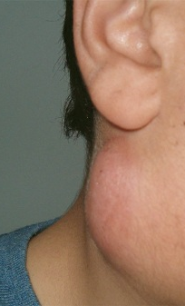
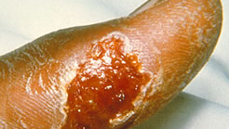
Predisposing & Occupational Risks Disease?
General symptoms include fever, headache, chills, nausea, and muscle and joint pain.
An ulcerated lesion at the site of bacteria inoculation occurs in about 80% of patients, including at the site of a tick bite or following other contact with Francisella tularemia such as in a cut on a finger or inside the mouth.
Complications can include swollen lymph nodes and pneumonia with cough and bloody sputum.

Slide 44
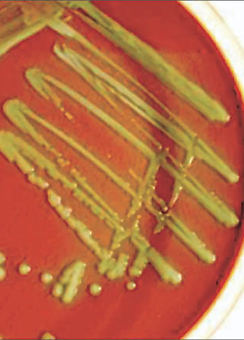
Infectious Dose?
10-50 organisms, 10 colony forming units
Due to its low infectious dose, ease of spread by aerosol, and high virulence, Francisella tularemia is classified as a T Select Agent by the U.S. government, along with other potential agents of bioterrorism such as Yersinia pestis, Bacillus anthracis and Ebola virus.

Slide 45
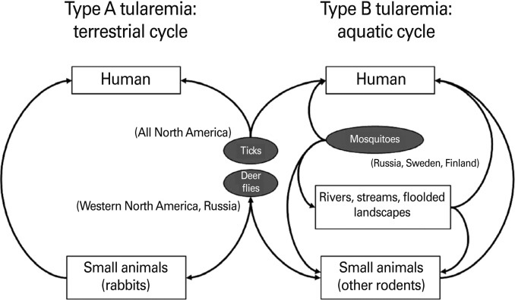
Mode of transmission?
Most infections are acquired when hunters handle infected small mammals, especially rabbits.
Some infections via ingestion of under cooked meat of infected small mammals, especially rabbits.
Some infections via handling infected aquatic mammals such as muskrats.
Some infections via ingestion of water that is contaminated with bacteria.
Via bites of infected deer flies in the western U.S. and infected ticks in the south central U.S.

Slide 46
Reference
https://www.ncbi.nlm.nih.gov/pmc/articles/PMC427758/
https://extension.entm.purdue.edu/publichealth/diseases/tabanid/tularemia.html
http://www.sciencedirect.com/science/article/pii/S1286457909001130
http://www.floradergisi.org/getFileContent.aspx?op=image&file_name=2010-15-2-037-058-Figure1.jpg
http://www.ppdictionary.com/bacteria/gnbac/tularensis.htm
http://thescopepopculturescience.blogspot.com/2015/06/8-cuddly-creatures-and-dark-deadly.html
https://jamanetwork.com/journals/jama/article-abstract/193894
https://www.researchgate.net/figure/236225836_fig1_Transmission-of-Francisella-tularensis-from-wild-animals-and-environments-to-human-Type

Slide 47
Pseudomonas Aeruginosa by: Lucia Abarca

Slide 48
Natural Habitat/ Environment
Most abundant organism on earth
Gram negative, rod shaped
soil
Water
Humans
Plants
Animals
Sewage
hospitals

Slide 49
Regions
Aquatic ecosystems
  Freshwater: lakes, ponds, rivers, streams
Found anywhere in the world, as any healthy individual is at risk to get pseudomonas aeruginosa

Slide 50
Reservoir
Usually detected in water reservoirs polluted by animals and humans
  Sewage and sinks inside and outside of hospitals
  Also in swimming pools and whirlpools
  Warm temperature favorable for growth
  In a hospital, found in respiratory equipment, food, sinks, taps, toilets, showers and mops

Slide 51
Host range
From humans to plants and animals, but humans being the main host
It can adhere to the epithelial cells through the use of fimbriae binding to specific receptors on host epithelial cells

Slide 52
Predisposing and occupation risk, disease? Infectious dose?
It colonizes in immunocompromised patients like those with cystic fibrosis, cancer, or AIDS
Infecting approximately 4 per 1000 discharged patients
Acquires for 10.1% of hospital infections
It’s an opportunistic human pathogen because it infects healthy individuals
  Mainly at medical centers
  Infectious dose unknown due to being an opportunistic pathogen

Slide 53
Mode of transmission
Hot Tub Rash
  DIRECT CONTACT with infected water will make the infected skin itchy and turn into a bumpy red color
  Can also infect plants
  In hospitals, infection is mainly through catheters
  Found on the skin of healthy persons

Slide 54
References
www.google.com
https://images.fineartamerica.com/images-medium-large/3-pseudomonas-aeruginosa-bacteria-sem-steve-gschmeissner.jpg
http://images.nailsmag.com/post/1-L-NA0309pseudomonas.jpg
http://www.medetec.co.uk/slide%20scans/leg-ulcer-images/images/leg-ulcers-0060.jpg

